Slide 1

Capability Print
Details of Capability Domains
Applicable to Policy Administration System Implementation
Deloitte Consulting LLP
June 15, 2012

Slide 2
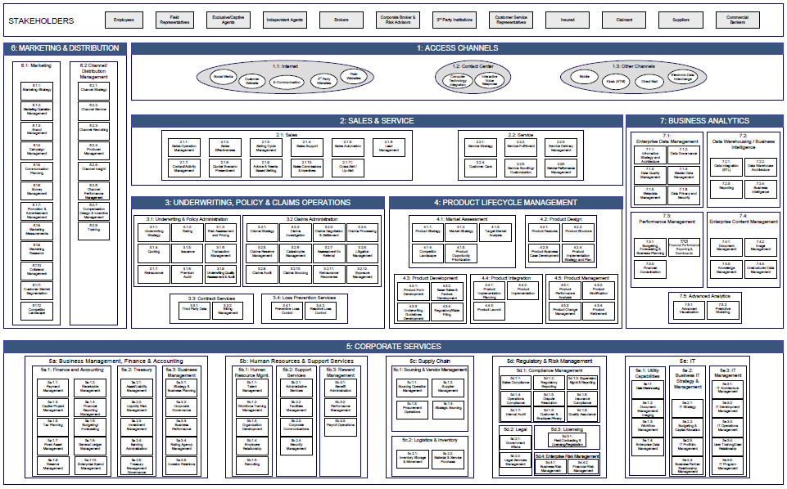
Capability Print Overview
This deck is focused on the capabilities affected by a Policy Administration System including the: Policy and Claims Operations, Product Lifecycle Management, and Business Analytics capability domains and the Underwriting & Policy Administration and Contract Services capability areas.
1: Access Channels
Property and Casualty Insurance Capability Print
In-scope for this deck
Out of scope for this deck
1.1 Internet
1.2 Contact Center
1.3 Other Channels
2: Sales & Service
2.1 Sales
2.2 Service
3: Underwriting, Policy & Claims Operations
3.1 Underwriting & Policy Administration
3.2 Claims Administration
3.3 Contract Services
3.4 Loss Prevention Services
4: Product Lifecycle Management
4.1 Market Assessment
4.2 Product Design
4.3 Product Development
4.4 Product Integration
4.5 Product Management
6: Marketing & Distribution
5: Corporate Services
7: Business Analytics
6.1 Marketing
6:2 Channel Distribution Management
5a Business Management, Finance, & Accounting
5b Human Resources and Support Services
5c Supply Chain
5d Regulatory and Risk Management
5e IT
7.1 Enterprise Data Management
7.2 Data Warehousing / Business Intelligence
7.3 Performance Management
7.4 Enterprise Content Management
7.5 Advanced Analytics

Slide 3
Underwriting & Policy Administration

Slide 4

3.1 Underwriting & Policy Administration
Property and Casualty Insurance Capability Print
3 UNDERWRITING, POLICY & CLAIMS OPERATIONS
3.1 Underwriting & Policy Administration
3.2 Claims Management
3.1.1
Underwriting Strategy
3.1.2
Rating
3.1.3
Risk Assessment and Pricing
3.2.1
Claims Strategy
3.2.2
Claims Investigation
3.2.3
Claims Negotiation and Settlement
3.2.4
Claims Processing
3.1.4
Quoting
3.1.5
Issuance
3.1.6
Transaction Management
3.2.5
Claims Reserve Management
3.2.6
Catastrophe Management
3.2.7
Assessment for Referral
3.2.8
Litigation Management
3.1.7
Reinsurance
3.1.8
Premium
Audit
3.1.9 Underwriting Assessment Quality & Audit
3.2.9
Claims Audit
3.2.10
Claims Sourcing
3.2.11
Reinsurance Recoveries
3.2.12
Exposure Management
3.3 Contract Services
3.4 Loss Prevention Services
3.3.1
Third Party Data
3.3.2
Billing Management
3.4.1
Preventive Loss Control
3.4.2
Reactive Loss Control

Slide 5
3.1 Underwriting & Policy Administration
 | Capability Definition | Competency | Competency Definition
3.1.1 Underwriting Strategy | Establishing how the underwriting function will organize and act to meet corporate objectives in conjunction with marketing, product, financial, risk and other strategies. | 3.1.1.1 Operational Objectives | Periodically develop, review and revise quantifiable business objectives for the underwriting organization.
 |  | 3.1.1.2 Operational Practices | Organize underwriters for maximum efficiency and effectiveness. Develop appropriate media to communicate underwriting policies and procedures.
 |  | 3.1.1.3 Authority Management | Define and delegate underwriting authority based upon premium amounts, limits, industry segments, etc. Distribute authority letters and to the extent possible, manage underwriting authority through technology.
 |  | 3.1.1.4 Reinsurance Strategy | Develop a strategy for the use of treaty or facultative reinsurance. Select and pre-qualify reinsurers.
3.1.2 Rating | Determination of premium amounts based on bureau, other advisory organization, and/or company standard risk characteristics. | 3.1.2.1 Bureau and Other Advisory Rates | Perform rating using bureau or other advisory organization rates and factors.
 |  | 3.1.2.2 Proprietary Company Rates | Perform rating using proprietary company rates and factors.
 |  | 3.1.2.3 Taxes, Fees, & Surcharges | Apply applicable taxes, fees and surcharges to premium, based upon location, LOB, or other factors to support downstream information needs.
Notes:
4

Slide 6
3.1 Underwriting & Policy Administration
 | Capability Definition | Competency | Competency Definition
3.1.3 Risk Assessment and Pricing | Determination of whether to write / accept a particular risk and the appropriate pricing and contract provisions for it. | 3.1.3.1 Eligibility / Pre-qualification Screening | Determine whether a risk is eligible based upon underwriting guidelines and product specifications (coverages, limits, locations, etc.).
 |  | 3.1.3.2 Qualification | Determine whether an applicant for an insurance policy meets established selection criteria. The qualification process may include prequalification steps in addition to the full qualification criteria.
 |  | 3.1.3.3 Risk Assessment | Determine acceptability of particular risk based on defined guidelines established according to company risk appetite; assess application with tools such as risk scoring or predictive modeling or both.
 |  | 3.1.3.4 Pricing | Determine final price, applying underwriting and rating guidelines and rules; adjust for experience and schedule modifications, facultative reinsurance, and other special situations (e.g., TPA for claims handling). Pricing may be driven by risk scoring or predictive modeling or both.
 |  | 3.1.3.5 Terms & Conditions | Develop declarations, schedules, endorsements, and other documents to complete the contract; determine need for loss control or other services. Depending upon the market and technology functionality, selection of terms and conditions may be pre-configured and technology driven or driven by the underwriter.
Notes:
5

Slide 7
3.1 Underwriting & Policy Administration
 | Capability Definition | Competency | Competency Definition
3.1.4 Quoting | Preparation and distribution of coverage based premium quotations and proposals to producers and applicants. | 3.1.4.1 Quote Preparation | Prepare communication to applicant / producer conveying proposed contract terms and pricing.
 |  | 3.1.4.2 Comparison Quoting | Present applicant with array of quotes fitting a variety of coverage, limit and deductible scenarios.
 |  | 3.1.4.3 Competitor Quoting | Present the applicant with likely quotes from competing insurers. (Currently only applies to personal lines.)
 |  | 3.1.4.4 Comparative Rating Services | Where applicable, deliver rates and pricing information to comparative rating services.
3.1.5 Issuance | Management of policy document issuance, including document generation. | 3.1.5.1 Binders | Prepare, distribute and manage coverage binders, establishing or creating legal notification.
 |  | 3.1.5.2 Policy Document Production | Produce policy document for insured and other key stakeholders and distribute through predetermined delivery methods.
 |  | 3.1.5.3 Policy Related Communications | Produce policy-related correspondence required for policyholder and other stakeholders and distribute through predetermined delivery methods.
Notes:
6

Slide 8
3.1 Underwriting & Policy Administration
 | Capability Definition | Competency | Competency Definition
3.1.6 Transaction Management | The processing of various types of transactions to initiate, modify, extend or terminate policy contracts and associated premium impacts (if any). All communication vehicles including upload/ download. | 3.1.6.1 New Business Management | Management of the receipt, processing and tracking of new business applications.
 |  | 3.1.6.2 Renewals and Non-renewals | Determine if a policy should be renewed for another term, and if so, at what price, based upon recent customer information. For non-renewals, arrange notifications to appropriate parties.
 |  | 3.1.6.3 Cancel / Rewrite | Cancel and reissue the same policy. Often used to circumvent system limitations on allowable changes to policy attributes.
 |  | 3.1.6.4 Endorsements | Manage riders, addendums, and attachments including non-premium bearing, future, back-dated, and out-of-sequence endorsements.
 |  | 3.1.6.5 Cancellation and Reinstatement | Terminate an insurance policy or bond before its expiration, by either the insured or the insurer. Re-activate a policy that has lapsed or has been cancelled.
 |  | 3.1.6.6 Producer of Record | Process customer requests to move policies to a different producer.
 |  | 3.1.6.7 Commissions Management | Process changes to standard commission structures as applied to individual policies or transactions for designated customers, at the behest or with the approval of the affected producer.
Notes:
7

Slide 9
3.1 Underwriting & Policy Administration
 | Capability Definition | Competency | Competency Definition
3.1.7 Reinsurance | Ability to identify and attach or purchase reinsurance to support company risk guidelines, tolerance, and coverage limits. | 3.1.7.1 Treaty Reinsurance | Identify situations where treaty reinsurance applies to potential insurance contract and attach; adjust terms, limits and pricing accordingly.
 |  | 3.1.7.2 Facultative Reinsurance | Determine when facultative reinsurance is required to meet an applicant’s needs while adhering to company guidelines on risk selection and coverage limits; place once determined it is required and make pricing adjustments accordingly.
3.1.8 Premium Audit | Audit of exposure basis for an insurance policy after the end of a policy period to determine the actual (audited) exposure for the purpose of making a final calculation of the premium and premium taxes. | 3.1.8.1 Audit Scheduling and Management | Establish and communicate schedule of audits to all involved parties based upon underwriting guidelines. Includes voluntary, telephonic, mail, physical or technology-based audits.
 |  | 3.1.8.2 Audit Execution | Perform the audits, including production of audit findings and present and confirm audit findings to policyholder, producer, and underwriter.
 |  | 3.1.8.3 Final Premium Calculation | Recalculate premium based upon audit results; initiate billing or refund activities.
3.1.9 Underwriting Quality Assessment & Audit | Management, monitoring and internal audits related to underwriting. | 3.1.9.1 Underwriting Quality Assurance | Review individual policies using audit sampling techniques and assess conformance of underwriting decisions to established rules and guidelines, pricing accuracy, and applicant / customer / producer satisfaction.
 |  | 3.1.9.2 Underwriting Management | Monitor underwriting performance and results, including individual, team and office performance against established standards for volume, timeliness, production and profitability target achievement.
Notes:
8

Slide 10
Contract Services

Slide 11
3.3 Contract Services
Property and Casualty Insurance Capability Print
3 UNDERWRITING, POLICY & CLAIMS OPERATIONS
3.1 Underwriting & Policy Administration
3.2 Claims Management
3.1.1
Underwriting Strategy
3.1.2
Rating
3.1.3
Risk Assessment and Pricing
3.2.1
Claims Strategy
3.2.2
Claims Investigation
3.2.3
Claims Negotiation and Settlement
3.2.4
Claims Processing
3.1.4
Quoting
3.1.5
Issuance
3.1.6
Transaction Management
3.2.5
Claims Reserve Management
3.2.6
Catastrophe Management
3.2.7
Assessment for Referral
3.2.8
Litigation Management
3.1.7
Reinsurance
3.1.8
Premium
Audit
3.1.9 Underwriting Assessment Quality & Audit
3.2.9
Claims Audit
3.2.10
Claims Sourcing
3.2.11
Reinsurance Recoveries
3.2.12
Exposure Management
3.3 Contract Services
3.4 Loss Prevention Services
3.3.1
Third Party Data
3.3.2
Billing Management
3.4.1
Preventive Loss Control
3.4.2
Reactive Loss Control

Slide 12
3.3 Contract Services
 | Capability Definition | Competency | Competency Definition
3.3.1 Third Party Data | Obtaining customer or exposure specific information through outside parties (e.g., MVR, credit reports) to improve ease of doing business, accuracy and consistency. | 3.3.1.1 Underwriting Information | Develop policies to govern the procurement and use of third party data in the underwriting process. Obtain and use third party data to inform underwriting decisions.
 |  | 3.3.1.2 Claims Information | Develop policies to govern the procurement and use of third party data in the claims management process. Obtain and use third party data to inform fraud triage, claims settlement and valuation decisions.
3.3.2 Billing Management | Production of bill / statement and receipts; performance of conservation and loan payment. | 3.3.2.1 Billing | Prepare and communicate demands for payment to producers, reinsurers or customers. Includes direct and agency billing arrangements. Billing could be for premiums, loss deductibles, reinsurance recoveries, or other situations where the company is owed money for contractual obligations. Includes all billing media.
 |  | 3.3.2.2 Collections | Monitor the receipt of premiums for policies per established due dates and schedules. Apply payments received from customers to the appropriate policies. Take appropriate action when premium payments are overdue, including customer follow-up, policy termination, and collections.
 |  | 3.3.2.3 Financial Arrangements | Establish the methods and schedules for customers to follow to make policy payments. Includes special financing arrangements common to large risks, including large deductible, self insured retention, and retrospective rating programs. Also includes support for installments, including competitive plans and fees to cover expenses.
Notes:
11

Slide 13
Product Lifecycle Management

Slide 14
4.1 Market Assessment
Property and Casualty Insurance Capability Print
4: PRODUCT LIFECYCLE MANAGEMENT
4.1 Market Assessment
4.2 Product Design
4.1.1
Product Strategy
4.1.2
Market Strategy
4.1.3
Target Market Analysis
4.2.1
Product Features
4.2.2
Product Structure
4.1.4
Competitor Landscape
4.1.5
Product Opportunity Prioritization
4.2.3
Product Business Case Development
4.2.4
Product Implementation Strategy and Plan
4.3 Product Development
4.4 Product Integration
4.5 Product Management
4.3.1
Product Form Development
4.3.2
Base Rates & Factors Development
4.4.1
Product Implementation Planning
4.4.2
Product Implementation
4.5.1
Product Performance Analysis
4.5.2
Product Modification
4.3.3
Underwriting Guidelines Development
4.3.4
Regulatory/State Filing
4.4.3
Product Launch
4.5.3
Product Change Management
4.5.4
Product Retirement

Slide 15
4.1 Market Assessment
 | Capability Definition | Competency | Competency Definition
4.1.1 Product Strategy | Development of product strategy in alignment with the company's financial targets and business goals. | 4.1.1.1 Financial Targets Definition | Establish profitability and operational targets at a product level that are consistent with strategic corporate targets.
 |  | 4.1.1.2 Product Strategy Management | Articulate product strategy based on defined financial targets and market assessment results. Continue to reevaluate and update product strategy on an ongoing basis.
4.1.2 Market Strategy | Development of market strategy that allows the company to concentrate its resources on the greatest opportunities to increase sales and achieve a sustainable competitive advantage. | 4.1.2.1 Market Strategy Review | Assess current market strategy including product alignment to overall business objectives.
 |  | 4.1.2.2 Product Mix Review | Leverage market strategy review to identify ideal product mix to maximize profit potential.
Notes:
14

Slide 16
4.1 Market Assessment
 | Capability Definition | Competency | Competency Definition
4.1.3 Target Market Analysis | Research approach to determine strengths / weaknesses of current products / services to determine demand and supply gaps in the market and to identify potential opportunities for new product launch. | 4.1.3.1 Overall Customer Characteristics | Research and identify customer characteristics in existing and potential markets, including: customer demographics, locations, loss potential, product needs, and buying behavior (i.e., channel preferences). Size the entire market to estimate the premium potential.
 |  | 4.1.3.2 Customer Targeting | Identify and continuously reevaluate the customer base to be targeted for current and future product. Identify opportunities in core, adjacent, or new markets.
 |  | 4.1.3.3 Distribution Assessment | Analyze existing capabilities and compare various channel opportunities. Define distribution strategy for product and services.
 |  | 4.1.3.4 Future Forecast Impact Assessment | Assess likely future impacts on industry and company performance based on emerging developments in the macro environment. (e.g., economics, customer sentiment, consumer product improvements and impairments, technology, legislation, and regulation)
Notes:
15

Slide 17
4.1 Market Assessment
 | Capability Definition | Competency | Competency Definition
4.1.4 Competitor Landscape | Research approach and criteria to gather information on competitors’ products and strategies for the short-term and long-term planning needs of the organization. | 4.1.4.1 Competitor Analysis | Understand competitors in terms of their financial status, product composition, market presence, management profile, etc.
 |  | 4.1.4.2 Competitive Position Analysis | Aggregate competitor product information and analyze as an input to product design. Includes coverage, rates, and target market.
4.1.5 Product Opportunity Prioritization | Element of the organization’s decision-making concerned with identifying and evaluating product opportunities that meet business objectives. | 4.1.5.1 Product Portfolio Evaluation | Evaluate products at differing stages of product lifecycle based on the results from Target Market Analysis and Performance Analysis (e.g. Introduction, Growth, Maturity, Decline) and identify candidates for expansion, enhancement, retirement, and identify product gaps.
 |  | 4.1.5.2 Strategic Planning to Align Products with Overall Business Objectives | Establish strategic plan for existing products and new products, evaluating the products ability to support short-term and long-term company goals.
Notes:
16

Slide 18
4.2 Product Design
Property and Casualty Insurance Capability Print
4: PRODUCT LIFECYCLE MANAGEMENT
4.1 Market Assessment
4.2 Product Design
4.1.1
Product Strategy
4.1.2
Market Strategy
4.1.3
Target Market Analysis
4.2.1
Product Features
4.2.2
Product Structure
4.1.4
Competitor Landscape
4.1.5
Product Opportunity Prioritization
4.2.3
Product Business Case Development
4.2.4
Product Implementation Strategy and Plan
4.3 Product Development
4.4 Product Integration
4.5 Product Management
4.3.1
Product Form Development
4.3.2
Base Rates & Factors Development
4.4.1
Product Implementation Planning
4.4.2
Product Implementation
4.5.1
Product Performance Analysis
4.5.2
Product Modification
4.3.3
Underwriting Guidelines Development
4.3.4
Regulatory/State Filing
4.4.3
Product Launch
4.5.3
Product Change Management
4.5.4
Product Retirement

Slide 19
4.2 Product Design
 | Capability Definition | Competency | Competency Definition
4.2.1 Product Features | Identification of appetite and design of product features that will appeal to the market. Ensure compliance with regulatory requirements. | 4.2.1.1 Underwriting Appetite Definition | Articulate the market opportunity and understand and define the risk level the company is willing to assume.
 |  | 4.2.1.2 Coverage Design | Select coverages that best serve the market demand and are consistent with underwriting appetite.
 |  | 4.2.1.3 Rating Model Design | Design the rating model structure (algorithms). Determine the data sources for building base rates and factors.
 |  | 4.2.1.4 Pricing Model Design | Define model for determining discretionary pricing threshold (i.e. debits and credits) based on customer attributes including unit level pricing, deductibles, limits, and retention. Determine whether predictive modeling will be used.
4.2.2 Product Structure | Establishment of efficient product architectures that provide opportunities to reuse common components in new market offerings. | 4.2.2.1 Product Inventory | Catalog of products and their associated coverages and sub-coverages.
 |  | 4.2.2.2 Product Architecture | Define line of business model for how coverages and sub-coverages are expressed with a focus on re-use.
 |  | 4.2.2.3 Product Data Model | Design streamlined process to minimize maintenance errors and aid regulatory compliance. Creates the foundation for business intelligence.
Notes:
18

Slide 20
4.2 Product Design
. | Capability Definition | Competency | Competency Definition
4.2.3 Product Business Case Development | Development of business case including financial projections, cost / benefit analysis, capability requirements, and success factors. | 4.2.3.1 Product Sales Projections | Build models to estimate sales volume and project future income cash flow; forecast the trend of sales volume as product matures.
 |  | 4.2.3.2 Product Profitability Projections | Evaluate expected loss ratios, capital requirements, and ROE targets.
 |  | 4.2.3.3 Product Expense Estimate | Estimate fixed and variable expense for writing and maintaining products.
 |  | 4.2.3.4 Product Monitoring Strategy | Determine strategy for monitoring product performance post product launch.
 |  | 4.2.3.5 Capabilities Feasibility Assessment | Determine feasibility of product implementation and management, including assessment of: system capacity, regulatory compliance, expertise, and cost.
Notes:
19

Slide 21
4.2 Product Design
. | Capability Definition | Competency | Competency Definition
4.2.4 Product Implementation Strategy and Plan | Development of strategy and plan for implementing the marketing, distribution, underwriting, policy administration, billing, financial reporting and regulatory reporting. | 4.2.4.1 Marketing Strategy Development | Determine advertising strategies including the selection of appropriate advertising channels for target customer.
 |  | 4.2.4.2 Distribution Strategy Development | Determine the distribution strategy for the product.
 |  | 4.2.4.3 Underwriting Strategy Development | Determine the strategy for informing the underwriters of new product’s features, rates and guidelines.
 |  | 4.2.4.4 Training Strategy Development | Develop training strategy and plan for formal training sessions for agents or employees about new product features, including overview of new system or technology.
 |  | 4.2.4.5 Systems Strategy Development | Develop strategy and plan for adopting new system or change existing system to support product implementation and maintenance.
Notes:
20

Slide 22
4.3 Product Development
Property and Casualty Insurance Capability Print
4: PRODUCT LIFECYCLE MANAGEMENT
4.1 Market Assessment
4.2 Product Design
4.1.1
Product Strategy
4.1.2
Market Strategy
4.1.3
Target Market Analysis
4.2.1
Product Features
4.2.2
Product Structure
4.1.4
Competitor Landscape
4.1.5
Product Opportunity Prioritization
4.2.3
Product Business Case Development
4.2.4
Product Implementation Strategy and Plan
4.3 Product Development
4.4 Product Integration
4.5 Product Management
4.3.1
Product Form Development
4.3.2
Base Rates & Factors Development
4.4.1
Product Implementation Planning
4.4.2
Product Implementation
4.5.1
Product Performance Analysis
4.5.2
Product Modification
4.3.3
Underwriting Guidelines Development
4.3.4
Regulatory/State Filing
4.4.3
Product Launch
4.5.3
Product Change Management
4.5.4
Product Retirement

Slide 23
4.3 Product Development
 | Capability Definition | Competency | Competency Definition
4.3.1 Product Form Development | Determination of specific coverages and exclusions for the product. | 4.3.1.1 Development of Coverage Forms | Develop the policy language that defines the coverage. Apply underwriting expertise to develop a customized policy form for a specific risk or a particular product.
 |  | 4.3.1.2 Development of Other Forms | Design of policy declarations, quote proposals, binders, applications and all other required policyholder notices. The ability to have dynamic forms that meet the needs of customers and distributor.
 |  | 4.3.1.3 Filing Requirement Compliance | Ensure that forms, contracts, and endorsements are in compliance with filing requirements.
4.3.2 Base Rates and Factors Development | Populate the rating model with base rates and factors. | 4.3.2.1 Develop Base Rates | Develop base rates utilizing data as described in the rating model design.
 |  | 4.3.2.2 Develop Rating Factors | Develop rating factors utilizing data as described in the rating model design.
 |  | 4.3.2.3 Develop Pricing Factors | Develop discretionary pricing factors based upon the underwriting guidelines or predictive modeling results.
Notes:
22

Slide 24
4.3 Product Development
 | Capability Definition | Competency | Competency Definition
4.3.3 Underwriting Guidelines Development | Develop underwriting guidelines. | 4.3.3.1 Develop Underwriting Guidelines | Develop set of guidelines or automated underwriting rules that define the process for assessing risk.
4.3.4 Regulatory/State Filing | Filing of forms, manuals, disclosure notices, rate plans etc. that must be provided to a given state insurance regulatory agency to ensure that the state will allow the given product to be sold / marketed within the state. | 4.3.4.1 Filing Planning | Establish understanding of state's filing requirement. Plan rate changes and new product implementation accordingly.
 |  | 4.3.4.2 Filing Support and Submission | Prepare form filing with legal involvement. Gather sufficient back-up data and information to support the proposed rate or rate change and prepare filing accordingly.
Notes:
23

Slide 25
4.4 Product Integration
Property and Casualty Insurance Capability Print
4: PRODUCT LIFECYCLE MANAGEMENT
4.1 Market Assessment
4.2 Product Design
4.1.1
Product Strategy
4.1.2
Market Strategy
4.1.3
Target Market Analysis
4.2.1
Product Features
4.2.2
Product Structure
4.1.4
Competitor Landscape
4.1.5
Product Opportunity Prioritization
4.2.3
Product Business Case Development
4.2.4
Product Implementation Strategy and Plan
4.3 Product Development
4.4 Product Integration
4.5 Product Management
4.3.1
Product Form Development
4.3.2
Base Rates & Factors Development
4.4.1
Product Implementation Planning
4.4.2
Product Implementation
4.5.1
Product Performance Analysis
4.5.2
Product Modification
4.3.3
Underwriting Guidelines Development
4.3.4
Regulatory/State Filing
4.4.3
Product Launch
4.5.3
Product Change Management
4.5.4
Product Retirement

Slide 26
4.4 Product Integration
 | Capability Definition | Competency | Competency Definition
4.4.1 Product Implementation Planning | Prepare organization to sell and service products to meet customer needs. | 4.4.1.1 Marketing and Distribution Channel Planning | Establish sales strategy and determine distribution methods to be used, outlining transaction process between insurer and customer.
 |  | 4.4.1.2 Associated Services Planning | Develop service plan to serve both customer and business needs. Associated services include: sales, third party data vendors, claim handling, customer service, and internal support.
4.4.2 Product Implementation | Identification, design, development and implementation of marketing, distribution, underwriting, policy administration, billing, financial reporting and regulatory reporting. | 4.4.2.1 Marketing Implementation | Adopt the marketing strategy including the selection of appropriate advertising channels for target customer.
 |  | 4.4.2.2 Distribution Implementation | Adopt the distribution strategy for product.
 |  | 4.4.2.3 Underwriting Implementation | Inform underwriters of new product’s features and rates. Produce and distribute underwriting guidelines documentation.
 |  | 4.4.2.4 Training Implementation | Conduct formal training sessions for agents or employees about new product features, including overview of new system or technology.
 |  | 4.4.2.5 Systems Implementation | Adopt new system or change existing system to support product implementation and maintenance.
 |  | 4.4.2.6 Product Monitoring Implementation | Configure product and reporting tools to carry out product monitoring strategy.
 |  | 4.4.2.7 Product Implementation Management | Establish timeframe and schedule for implementation and coordinate changes required for different areas .
Notes:
25

Slide 27
4.4 Product Integration
 | Capability Definition | Competency | Competency Definition
4.4.3 Product Launch | Launch of a new product in a limited pre-defined market based on earlier assessments to gauge product performance. | 4.4.3.1 Product Test Marketing | Consult with distribution channel to better assess the feasibility and competitiveness.
 |  | 4.4.3.2 Product Pilot Launch | Deploying all solutions (technology, service and design) into the pilot and running the pilot.
 |  | 4.4.3.3 Product Pilot Assessment | Evaluate pilot launch results and identify system or product issues to make adjustments prior to formal implementation.
 |  | 4.4.3.4 Full Launch | Launch product into marketplace.
Notes:
26
4.4.3 - Marketing Impementation - Strategy, Plan, Build
, Marketing, Distribution, Underwriting, Communication, Launch, Training, Systems Strategy and Plan,

Slide 28
4.5 Product Management
Property and Casualty Insurance Capability Print
4: PRODUCT LIFECYCLE MANAGEMENT
4.1 Market Assessment
4.2 Product Design
4.1.1
Product Strategy
4.1.2
Market Strategy
4.1.3
Target Market Analysis
4.2.1
Product Features
4.2.2
Product Structure
4.1.4
Competitor Landscape
4.1.5
Product Opportunity Prioritization
4.2.3
Product Business Case Development
4.2.4
Product Implementation Strategy and Plan
4.3 Product Development
4.4 Product Integration
4.5 Product Management
4.3.1
Product Form Development
4.3.2
Base Rates & Factors Development
4.4.1
Product Implementation Planning
4.4.2
Product Implementation
4.5.1
Product Performance Analysis
4.5.2
Product Modification
4.3.3
Underwriting Guidelines Development
4.3.4
Regulatory/State Filing
4.4.3
Product Launch
4.5.3
Product Change Management
4.5.4
Product Retirement

Slide 29
4.5 Product Management
 | Capability Definition | Competency | Competency Definition
4.5.1 Product Performance Analysis | Continuous monitoring of the actual performance against the expected performance including determining corrective actions as needed. | 4.5.1.1 Product Feedback Monitoring | Solicit, compile and evaluate feedback from external parties(Customers, Agents, Employees) on various aspects of product performance i.e., marketing, advertising, promotional campaign, sale-ability, system issues, and competitor reaction.
 |  | 4.5.1.2 Product Production Monitoring | Monitor product sales against established targets and develop corrective actions to address issues.
 |  | 4.5.1.3 Product Experience Monitoring | Monitor product profitability with focus on loss development and expenses.
 |  | 4.5.1.4 Loss Projections and Reserving Guidelines | Analyze loss development pattern to project future potential loss of all products in a company's portfolio and establish reserves accordingly.
 |  | 4.5.1.5 Market Share Monitoring | Assess overall product performance by monitoring macro environmental factors and company position against quantifiable metrics, including written premium change, account retention ratio, account-level quote number, and close ratio.
Notes:
28

Slide 30
4.5 Product Management
 | Capability Definition | Competency | Competency Definition
4.5.2 Product Modification | Activities for supporting changes to an existing product in the market. | 4.5.2.1 Modification Needs Identification | Analyze external environment, overall market trends, and internal factors to identify maintenance, compliance, and product enhancement requirements.
 |  | 4.5.2.2 Potential Modification Areas Identification | Based on research results and modification needs, determine specific aspects of the product to modify.
 |  | 4.5.2.3 Rates Location Analysis and Regulatory Compliance | Determine necessary rate changes for specific geographic areas or customer segments or both and ensure the proposed changes are in compliance with regulatory requirements.
 |  | 4.5.2.4 Optimization of Modification Plan | Develop optimal modification plan, considering: resources required to implement changes to product features, rates or marketing plans and estimated impacts.
Notes:
29

Slide 31
4.5 Product Management
 | Capability Definition | Competency | Competency Definition
4.5.3 Product Change Management | Support required to implement changes to a given product, including updating state filings, marketing materials, training courses, and all other aspects related to supporting the product. Also includes analysis of the potential impact to the book of business if changes are made to a product. | 4.5.3.1 Product Change Implementation Coordination | Develop tactics related to product change implementation (e.g., task lists, resource assignments and schedules). Identify stakeholders for communication and status tracking. Confirm impact analyses.
 |  | 4.5.3.2 Product Change Communication | Communicate product changes to all stakeholders.
4.5.4 Product Retirement | Removal of a given product from the market. | 4.5.4.1 Product Run-off Planning | Establish strategy for retiring an under-performing or obsolete product. Conduct impact assessment on all relevant stakeholders and establish mitigation plans.
 |  | 4.5.4.2 Product Retirement Communications | Manage communications pertaining to product retirement with internal and external stakeholders.
 |  | 4.5.4.3 Transition Management | Implement transition strategy and plans for impacted stakeholders.
Notes:
30

Slide 32
Business Analytics

Slide 33
7.1 Enterprise Data Management
7: BUSINESS ANALYTICS
7.1 Enterprise Data Management
7.2 Data Warehousing / Business Intelligence
7.1.1
Information Strategy and Architecture
7.1.2
Data Governance
7.2.1
Data Integration (ETL)
7.2.2
Data Warehouse Architecture
Property and Casualty Insurance Capability Print
7.1.3
Data Quality Management
7.1.4
Master Data Management
7.2.3
Reporting
7.2.4
Business Intelligence
7.1.5
Metadata Management
7.1.6
Data Privacy and Security
7.3 Performance Management
7.4 Enterprise Content Management
7.3.1
Budgeting Forecasting & Business Planning
7.3.2
Financial Performance Reporting & Dashboards
7.4.1
Document Management
7.4.2
Image Management
7.3.3
Financial Consolidation
7.4.3
Knowledge Management
7.4.4
Unstructured Data Management
7.5 Advanced Analytics
7.5.1
Advanced Visualization
7.5.2
Predictive Modeling

Slide 34
7.1 Enterprise Data Management
 | Capability Definition | Competency | Competency Definition
7.1.1 Information Strategy and Architecture | Identify and lay out architectural components that provide a framework to facilitate storage, integration, usage, access, and delivery of data assets across the enterprise. | 7.1.1.1 Strategy Pathway | Define the future-state vision and information needs that support the client’s business strategy and identifies gaps in the organization’s current information capabilities.
 |  | 7.1.1.2 Data Life Cycle, Retention and Archiving | Manage the collection, preservation, and retirement of enterprise data assets to support application migrations, historical management reporting and regulatory compliance.
7.1.2 Data Governance | Establish organizational constituencies and a framework of policies, processes, and enabling technologies to ensure that enterprise data is owned and stewarded accurately and consistently to meet business goals. | 7.1.2.1 Organization Data Governance | Define the roles and responsibilities for parties involved in providing information governance and stewardship.
 |  | 7.1.2.2 Technology Data Governance | Define the architecture and role of technology in maintaining a consistent view across all core master data elements.
 |  | 7.1.2.3 Policy Data Governance | Institutionalize the data governance organization by clearly laying out the necessity for Data Governance activities as well as the consequences for not adhering to Data Governance standards.
 |  | 7.1.2.4 Process Data Governance | Establish functional processes for data management, change control, data quality and Service Level Agreements.
 |  | 7.1.2.5 Compliance Data Governance | Measure the organization’s performance around data compliance.
Notes:
33

Slide 35
7.1 Enterprise Data Management
 | Capability Definition | Competency | Competency Definition
7.1.3 Data Quality Management | Establish a framework and supporting processes and procedures to appropriately diagnose data quality issues, remediate them, and monitor the data quality to keep evergreen content. | 7.1.3.1 Data Completeness | Define the appropriate data values that should be readily available in a usable state.
 |  | 7.1.3.2 Data Conformity | Define that all data values reside in a specific format.
 |  | 7.1.3.3 Data Consistency | Ensure all data values so they are consistent across all data sources.
 |  | 7.1.3.4 Data Accuracy | Ensure that the data objects accurately represent the “real world” business values they are expected to model.
 |  | 7.1.3.5 Data Duplication | Ensure that there are no unnecessary representations of the same data objects within a given data set.
 |  | 7.1.3.6 Data Integrity | Ensure the representational faithfulness of information to the true state of the object.
Notes:
34

Slide 36
7.1 Enterprise Data Management
 | Capability Definition | Competency | Competency Definition
7.1.4 Master Data Management | Address the harmonization and integrity of enterprise data which is vital to a consistent and complete view of master data across the enterprise. | 7.1.4.1 MDM Organization | Define the people responsible for owning and maintaining the master data. It specifies the organization model, names data stewards and owners, and establishes the resources responsible for maintenance.
 |  | 7.1.4.2 MDM Standards | Define guidelines and rules for creating and maintaining master data. This includes rule sets for data architecture, data modeling and the creation of data domains and elements.
 |  | 7.1.4.3 MDM Technology | Define and create the data architecture that enables MDM. This includes define, select, deploy, monitor, and maintain technologies for tasks such as data cleansing, data integration and performance monitoring.
 |  | 7.1.4.4 MDM Processes | Define the procedures for the creation of new elements as well as the integration and harmonization of existing elements.
 |  | 7.1.4.5 MDM Governance | Specify the policies and procedures for maintaining the master data. It should establish accountability, set goals for the organization and define monitoring and enforcement.
7.1.5 Metadata Management | Manage any information or knowledge about data possessed by an organization. It facilitates enterprise-wide data standardization throughout its lifecycle. | 7.1.5.1 Metadata Organization Framework | Develop the organization structure and roles needed to support metadata management.
 |  | 7.1.5.2 Metadata Repository | Design and implementation of a centralized business rules, data standards, and data definitions that is referenced across the enterprise.
 |  | 7.1.5.3 Metadata Architecture | Establish the metadata architecture and the metadata capture and storage processes.
Notes:
35

Slide 37
7.1 Enterprise Data Management
 | Capability Definition | Competency | Competency Definition
7.1.6 Data Privacy and Security | Ensure that information is appropriately encrypted, accessed, and used as per policy guidelines. It focuses on securing enterprise data assets from any unauthorized infringement. It ensures that appropriate data security and access policies, checks, and controls are monitored. | 7.1.6.1 Data Privacy and Security Strategy | Define the objectives and approach for enabling the governance, process and technology components supporting the data privacy and data protection program including an implementation roadmap.
 |  | 7.1.6.2 Data Privacy and Security Requirements Framework | Identify and rationalize privacy and data protection requirements across identified laws, regulations, and policies into a set of rationalized requirements to guide the analysis and design of data privacy policies, procedures, and data protection solutions.
 |  | 7.1.6.3 PII Data Lifecycle Analysis Framework | Define PII data elements and develop an approach to facilitate the analysis of the PII data lifecycle components.
 |  | 7.1.6.4 PII Risk Assessment Framework | Assess risks associated with PII data to identify controls, requirements, profiles and potential threats and impacts.
 |  | 7.1.6.5 Data Privacy and Policy Breach Response | Define an approach to monitor for, alert on and appropriately respond to data privacy breaches.
 |  | 7.1.6.6 Data Privacy Transformation | Define roles & responsibilities for communicating and executing the data privacy and data security framework. Define an exception process for handling cultural and organizational constraints.
Notes:
36

Slide 38
7.2 Data Warehousing / Business Intelligence
7: BUSINESS ANALYTICS
7.1 Enterprise Data Management
7.2 Data Warehousing / Business Intelligence
7.1.1
Information Strategy and Architecture
7.1.2
Data Governance
7.2.1
Data Integration (ETL)
7.2.2
Data Warehouse Architecture
Property and Casualty Insurance Capability Print
7.1.3
Data Quality Management
7.1.4
Master Data Management
7.2.3
Reporting
7.2.4
Business Intelligence
7.1.5
Metadata Management
7.1.6
Data Privacy and Security
7.3 Performance Management
7.4 Enterprise Content Management
7.3.1
Budgeting Forecasting & Business Planning
7.3.2
Financial Performance Reporting & Dashboards
7.4.1
Document Management
7.4.2
Image Management
7.3.3
Financial Consolidation
7.4.3
Knowledge Management
7.4.4
Unstructured Data Management
7.5 Advanced Analytics
7.5.1
Advanced Visualization
7.5.2
Predictive Modeling

Slide 39
7.2 Data Warehousing / Business Intelligence
 | Capability Definition | Competency | Competency Definition
7.2.1 Data Integration (ETL) | Establish the functions and processes necessary to combine and transform data residing in different sources to a target system that provides users with a unified view of the data. | 7.2.1.1 ETL Strategy Pathway | Define the future-state vision of data sourcing, transformation methodologies and frameworks needed that will support the design of the future-state ETL/ELT process for the transition of enterprise data.
 |  | 7.2.1.2 ETL Process and Architecture | Define the organization, tools and processes required to provide the foundation for an enterprise data movement strategy.
 |  | 7.2.1.3 ETL Data Transformation | Establish the process necessary to convert data from a source data format into destination data.
 |  | 7.2.1.4 ETL Data Loading | Adopt the control structures and processes for data loading and error handling.
 |  | 7.2.1.5 ETL Production Operation | Define the production operation framework required to sustain and support the ETL processes.
7.2.2 Data Warehouse Architecture | The functional, technical requirements and framework for implementing the delivery of information to allow enterprise decision-making. | 7.2.2.1 Data Warehouse Technical Architecture Framework | Develop a layout of the data processing environment and the associated standards and procedures.
 |  | 7.2.2.2 Data Warehouse Organization | Establish the organization required to provide the foundation for an enterprise data warehouse.
 |  | 7.2.2.3 Data Warehouse Information Models | Develop an integrated view of organizational data that documents and organizes business data created by business processes for communication between functional and technical people.
 |  | 7.2.2.4 Data Warehouse BI Tools | Adopt reporting technologies designed to improve the productivity of decision makers and preserve information consistency throughout an organization.
Notes:
38

Slide 40
7.2 Data Warehousing / Business Intelligence
 | Capability Definition | Competency | Competency Definition
7.2.3 Reporting | Provision the information needed to support decision-makers within an organization. | 7.2.3.1 Enterprise Reporting | Ability to generate reports that provide a holistic view of various aspects of business results.
 |  | 7.2.3.2 Enterprise Report Management | Ability to manage the organization’s reports, including volume and sizing analysis, and storage and retrieval options.
7.2.4 Business Intelligence | Ability to report, monitor and measure business performance. Allows an organization to take all its capabilities and convert them into knowledge to support better business decision-making. | 7.2.4.1 BI Organizational Model | Define the roles and responsibilities necessary to support the BI model.
 |  | 7.2.4.2 BI Service and Support | Define the BI services that will be provided and how they will be supported.
 |  | 7.2.4.3 BI Technology and Process Management | Adopt architectural standards , the process to manage the technology stack and the vendors across the enterprise for BI solutions.
Notes:
39

Slide 41
7.3 Performance Management
7: BUSINESS ANALYTICS
7.1 Enterprise Data Management
7.2 Data Warehousing / Business Intelligence
7.1.1
Information Strategy and Architecture
7.1.2
Data Governance
7.2.1
Data Integration (ETL)
7.2.2
Data Warehouse Architecture
Property and Casualty Insurance Capability Print
7.1.3
Data Quality Management
7.1.4
Master Data Management
7.2.3
Reporting
7.2.4
Business Intelligence
7.1.5
Metadata Management
7.1.6
Data Privacy and Security
7.3 Performance Management
7.4 Enterprise Content Management
7.3.1
Budgeting Forecasting & Business Planning
7.3.2
Financial Performance Reporting & Dashboards
7.4.1
Document Management
7.4.2
Image Management
7.3.3
Financial Consolidation
7.4.3
Knowledge Management
7.4.4
Unstructured Data Management
7.5 Advanced Analytics
7.5.1
Advanced Visualization
7.5.2
Predictive Modeling

Slide 42
7.3 Performance Management
 | Capability Definition | Competency | Competency Definition
7.3.1 Budgeting, Forecasting and Business Planning | Develop driver-based models which are linked to performance targets and support an integrated forecast and budget process using a rolling forecast approach. | 7.3.1.1 Model Development | Create performance metrics models for use in corporate financial forecasts and operational management reports.
 |  | 7.3.1.2 Integrated Forecasting and Budgeting | Combine information from various sources within and outside the organization for use in preparing ongoing forecasts of business performance. Includes the use of financial, performance and service level data and metrics.
7.3.2 Financial Performance Reporting and Dashboards | Provide a unified view of an organization's budget and actual performance reporting. | 7.3.2.1 Performance Dashboards and Scorecards | Establish the presentation of key performance indicators (KPIs) and metrics that are visually oriented and graphical, linked via drill down functionality to supporting detailed information, and simply presented to facilitate action.
 |  | 7.3.2.2 Management Reporting and Analysis | Utilize a combination of reporting platform that focus on the strategy, standardization and development of financial and management reporting solutions.
 |  | 7.3.2.3 Activity and Value Based Management | Develop the tools used to help align a company’s goals and decision making with key drivers of value.
7.3.3 Financial Consolidation | Adopt the process needed to consolidate financial results including the automation of key aspects such as intercompany eliminations, currency translation, minority interest calculation and cash flow. | 7.3.3.1 Close and Consolidation | Establish the journal entry made at the end of the accounting period combining assets, equity, liabilities and operating accounts into one financial statement.
Notes:
41

Slide 43
7.4 Enterprise Content Management
7: BUSINESS ANALYTICS
7.1 Enterprise Data Management
7.2 Data Warehousing / Business Intelligence
7.1.1
Information Strategy and Architecture
7.1.2
Data Governance
7.2.1
Data Integration (ETL)
7.2.2
Data Warehouse Architecture
Property and Casualty Insurance Capability Print
7.1.3
Data Quality Management
7.1.4
Master Data Management
7.2.3
Reporting
7.2.4
Business Intelligence
7.1.5
Metadata Management
7.1.6
Data Privacy and Security
7.3 Performance Management
7.4 Enterprise Content Management
7.3.1
Budgeting Forecasting & Business Planning
7.3.2
Financial Performance Reporting & Dashboards
7.4.1
Document Management
7.4.2
Image Management
7.3.3
Financial Consolidation
7.4.3
Knowledge Management
7.4.4
Unstructured Data Management
7.5 Advanced Analytics
7.5.1
Advanced Visualization
7.5.2
Predictive Modeling

Slide 44
7.4 Enterprise Content Management
 | Capability Definition | Competency | Competency Definition
7.4.1 Document Management | Ability to create, manage, and share electronic documents that allows for storage, retrieval, tracking, and administration of documents within an organization. Includes workflow management, security and permissions assignment, document search, metadata entry, and access / creation / editing / version control of documents. | 7.4.1.1 Digital Asset Management | Develop the management tasks and decisions surrounding the ingestion, annotation, cataloguing, storage, retrieval and distribution of digital assets.
 |  | 7.4.1.2 Web Content Management (WCM) | Define the collection of procedures for publishing, editing, and modifying content as well as site maintenance for enterprise web sites.
7.4.2 Image Management | Ability to capture, store, and retrieve paper documents (e.g., faxes, letters) with intelligent tools for capturing information into metadata fields using OCR/ICR technologies. | 7.4.2.1 Records \ Forms Management | Define the compliance-focused records management organization to manage records critical to the operation of the business.
Notes:
43

Slide 45
7.4 Enterprise Content Management
 | Capability Definition | Competency | Competency Definition
7.4.3 Knowledge Management | Adopt processes that govern the creation, dissemination, and utilization of knowledge. Encompasses aspects such as performance improvement, competitive advantage, product and services innovation, process development, project-based lessons learnt, and the development of collaborative practices. | 7.4.3.1 E-discovery and search | Enable information delivery to the desktop via search engines, ultimately enabling the provisioning of information across the entire Internet / intranet.
 |  | 7.4.3.2 Knowledge Repository Management | Create and manage a central electronic library to store and facilitate access to corporate information resources.
 |  | 7.4.3.3 Enterprise Collaboration / Content Management | Ability to support enterprise-wide communications and share documents and knowledge to specific teams and individuals within the enterprise by utilizing a combination of groupware, tools, intranets, extranets and other networks.
7.4.4 Unstructured Data Management | Manage data created and stored outside of formal templates. | 7.4.1.1 Unstructured Data Inventory | Inventory and evaluate the potential benefits versus the costs and difficulty of managing unstructured data.
 |  | 7.4.1.2 Unstructured Data Architecture | Identify and manage metadata including identifying the linkages among unstructured data and identifying unstructured data workflows.
 |  | 7.4.1.3 Enterprise Data Mark-up | Utilize markup or tagging schemes to attach metadata to unstructured data, allowing the data to be “joined” with structured data.
 |  | 7.4.1.4 Unstructured Data Governance | Oversight of unstructured data and the associated linkages and workflows. Includes auditing of the markup of unstructured data.
Notes:
44

Slide 46
7.5 Advanced Analytics
7: BUSINESS ANALYTICS
7.1 Enterprise Data Management
7.2 Data Warehousing / Business Intelligence
7.1.1
Information Strategy and Architecture
7.1.2
Data Governance
7.2.1
Data Integration (ETL)
7.2.2
Data Warehouse Architecture
Property and Casualty Insurance Capability Print
7.1.3
Data Quality Management
7.1.4
Master Data Management
7.2.3
Reporting
7.2.4
Business Intelligence
7.1.5
Metadata Management
7.1.6
Data Privacy and Security
7.3 Performance Management
7.4 Enterprise Content Management
7.3.1
Budgeting Forecasting & Business Planning
7.3.2
Financial Performance Reporting & Dashboards
7.4.1
Document Management
7.4.2
Image Management
7.3.3
Financial Consolidation
7.4.3
Knowledge Management
7.4.4
Unstructured Data Management
7.5 Advanced Analytics
7.5.1
Advanced Visualization
7.5.2
Predictive Modeling

Slide 47
7.5 Advanced Analytics
 | Capability Definition | Competency | Competency Definition
7.5.1 Advanced Visualization | Ability to visualize data in multiple ways from multiple perspectives on the screen at once. Construction of a comprehensive view and spot relationships, which would be impossible to see if one were forced to examine each view independently. | 7.5.1.1 Information Visualization | Enable users to see, explore, and understand large amounts of information at once utilizing visual representation and interaction techniques. Information visualization focuses on the creation of approaches for conveying abstract information in intuitive ways.
 |  | 7.5.1.2 Geospatial Visualization | Connect data to geography to build compelling visualizations from diverse information sources. Exploring both quantitative and qualitative spatial relationships within large data sets of structured and unstructured content represented geographically.
Notes:
46

Slide 48
7.5 Advanced Analytics
 | Capability Definition | Competency | Competency Definition
7.5.2 Predictive Modeling | Apply statistical techniques to predict future outcomes and improve the overall ability to segment a population on the basis of expected outcomes. Enable mathematical algorithms that detect actionable patterns and trends in data. Also includes the creation of statistical and analytical models via enrichment of data using 3rd party sources. | 7.5.2.1 Customer Analytics | Apply techniques that analyze customer behavior to support and enable profitability analysis, fraud management, customer persistency analysis, market segmentation and other customer oriented topics to make predictions about future events.
 |  | 7.5.2.2 Risk Analytics | Adopt techniques to identify and assess factors that may jeopardize the success of another capability. Utilized to support premium leakage management, fraud management, and product experience projections, this competency also helps to define preventive measures to reduce the probability of these factors from occurring and identify countermeasures to successfully mitigate these constraints if they develop to avert possible negative effects on the competitiveness of the company.
 |  | 7.5.2.3 Marketing Analytics | Apply techniques to support lead generation, effective campaign management, segment profitability analysis, and evaluate distribution channel effectiveness. Marketing analytics focuses on the alignment of marketing activities, strategies, and metrics with business goals to achieve key outcomes and objectives to evaluate the efficiency and effectiveness of marketing.
 |  | 7.5.2.4 Claims Analytics | Apply techniques to improve detection of potentially fraudulent situations, analyze the efficiency of claims operations and support litigation management.
Notes:
47

Slide 49
Appendix

Slide 50
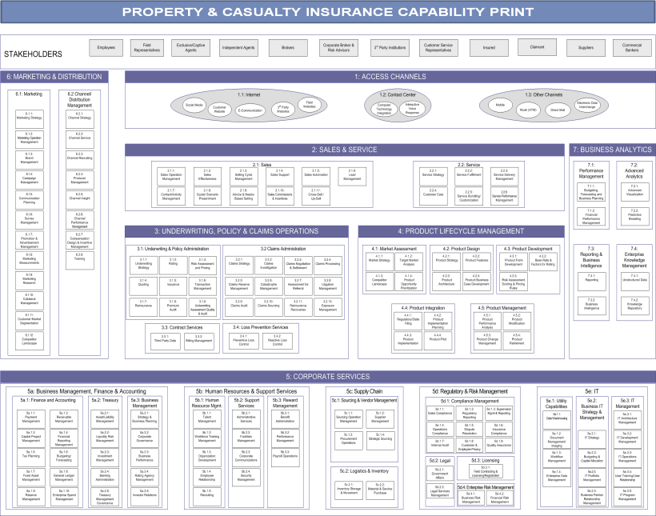
Introduction to Property & Casualty Insurance Capability Print
The P&C Insurance Capability Print identifies capabilities required of leading P&C insurance organizations to write and service policies effectively
Capability Print and Domains
Capability Areas
2
Capability Domain groups capabilities along functional domains of the organization
The following capability domains are included in the Capability Print:
Access Channels
Sales & Service
Underwriting, Policy & Claim Operations
Product Lifecycle Management
Corporate Services
Marketing & Distribution
Business Analytics
Bold indicates capability domains in-scope for PAS
1
3.1 Underwriting & Policy Administration
3.1.1
Underwriting Strategy
3.1.2
Rating
3.13 Risk Assessment and Pricing
3.1.4
Quoting
3.1.5
Issuance
3.1.6
Transaction Management
Capability Areas are discrete business functions essential to capability domain operations and are comprised of one or more capabilities
Capabilities
Competencies
3
3.1.1
Underwriting Strategy
4
3.1.1 Underwriting Strategy | 3.1.1.1 Operational Objectives
 | 3.1.1.2 Operational Policies
Capabilities are a collection of competencies required to enable a capability area
Competencies are the specific activities performed to enable their parent capability

Slide 51
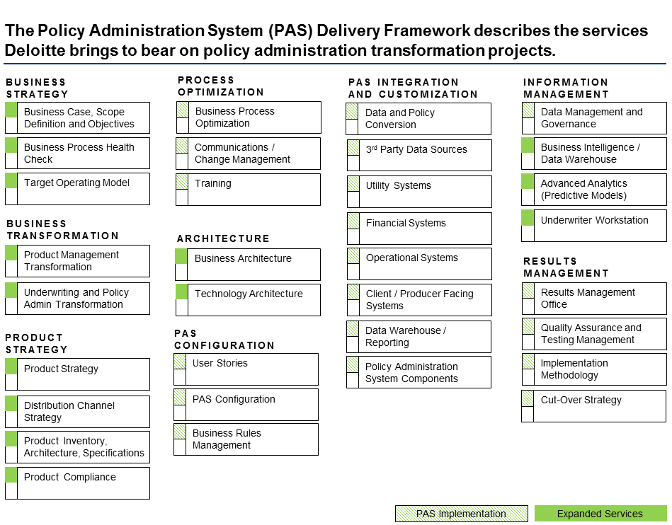
Capability Print as Foundation
Capability Print will inform the development of assets required for PAS implementation as well as expanded services that will be complementary to a PAS implementation
Capability Print
PAS Delivery Framework
Property and Casualty Insurance Capability Print
Comprehensive inventory of capability domains across the P&C enterprise | Support identification of opportunity areas in an organization; define scope and objectives focus for PAS implementation and expanded services Prepare to conduct process health checks in multiple areas (product, business process, and underwriting)
Defined competencies for PAS-related capability domains (e.g., Policy Lifecycle) and capability areas (e.g., New Business Management) | Document and evaluate current state activities and define future ones Identify areas for business process optimization based on leading practices

